Slide 1
Block Chain Architecture
Unit II

Slide 2
Contents
Blockchain Architecture
Versions
Variants
Life use cases of blockchain
Blockchain vs shared Database
Introduction to crypto currencies
Applications of Crypto currencies

Slide 3
Core Components of Blockchain Architecture
Node
User or computer within the blockchain architecture (each has an independent copy of the whole blockchain ledger)
Transaction
Smallest building block of a blockchain system (records, information, etc.) that serves as the purpose of blockchain

Slide 4
Block
A data structure used for keeping a set of transactions which is distributed to all nodes in the network
Each blockchain block consists of
Data: Each block contains a list of transactions.
Hash: Each block has a unique identifier called a hash, generated from the block's data.
Previous Hash: Each block also contains the hash of the previous block, creating a chain.

Slide 5
P2P Network
The blockchain is a peer to peer (P2P) network working on the IP protocol. A P2P network is a flat topology with no centralized node. P2P networks are generally more secure because they do not have a single point of attack or failure as in case of a centralized network.
A blockchain network can be a permission-based network as well as a permissionless network. A permissionless network is also known as public blockchain because anyone can join the network, while a permission-based blockchain is called a consortium blockchain. A permission-based blockchain or private blockchain requires pre-verification of the participants within the network and these parties are usually known to each other.

Slide 6
Consensus (consensus protocol)
A set of rules and arrangements to carry out blockchain operations
The consensus mechanism ensures that whatever local copy every individual party has, they are consistent with each other and is the most updated one.
Some of the consensus algorithms are:
Proof-of-Work(POW)
Proof of Stake(POS)

Slide 7
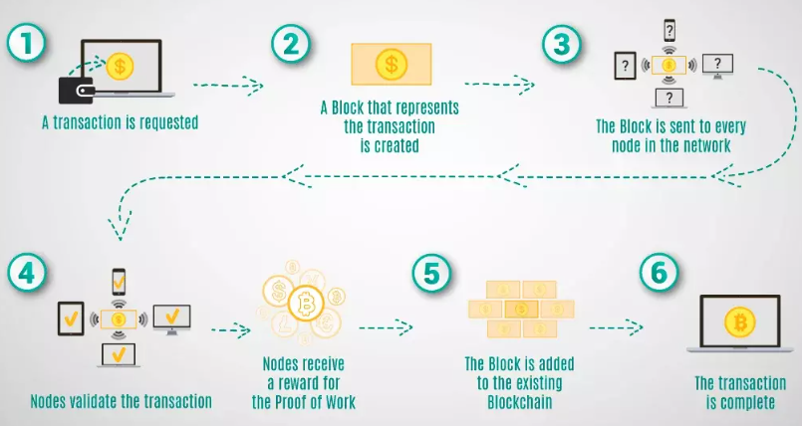

Slide 8
There are Three Version’s of Blockchain:
BlockChain 1.0 (Cryptocurrency) – BlockChain Version 1.0 was introduced in 2005 by Hall Finley, who implements DLT (Distributed Ledger Technology) represents its first application based on Crypto currency. This allows Financial Transaction based on BlockChain technology or DLT which is executed with the help of BitCoin. This type of Version is permissionless as any participant will perform valid transaction of Bitcoin. This type is mainly used in Currency and Payments.

Slide 9
BlockChain 2.0 ( Smart Contracts) – The new Version of BlockChain come because there is a problem in version 1.0 which was Mining of BitCoin was Wasteful and there was also lack of Scalability of Network in it. So problem is improved in Version 2.0. In this version, the BlockChain is not just limited to Cryptocurrencies but it will extend up to Smart Contracts.
Smart contracts are contracts that are written in code and designed to follow a set of instructions. They are safe, devoid of third-party interference, transparent, and precise.
In BlockChain 2.0, BitCoin is replaced with Ethereum. Thus, BlockChain 2.0 was successfully processing high number of Transactions on Public network rapidly.

Slide 10
3. BlockChain 3.0 (DApps) –
Decentralized apps, or DApps, are essentially a collection of linked smart contracts. Smart contracts are computer programs that carry out a set of instructions. DApps are decentralized apps that combine smart contracts into packages that can be interacted with by users

Slide 11
Types of Block Chain Architecture(variants)
Public:
In this type of blockchain, ledgers are visible to everyone on the internet. It allows anyone to verify and add a block of transactions to the blockchain. Public networks have incentives for people to join and are free for use. Anyone can use a public blockchain network.
Public blockchain does not have any central authority controlling or directing its operations
Transactions on a public blockchain are public and visible to anyone through explorers.
Examples include Bitcoin and Ethereum blockchains.

Slide 12
As the name is public this blockchain is open to the public, which means it is not owned by anyone.
Anyone having internet and a computer with good hardware can participate in this public blockchain.
All the computer in the network hold the copy of other nodes or block present in the network
In this public blockchain, we can also perform verification of transactions or records

Slide 13
Advantages:
Trustable: There are algorithms to detect no fraud. Participants need not worry about the other nodes in the network
Secure: This blockchain is large in size as it is open to the public. In a large size, there is greater distribution of records
Anonymous Nature: It is a secure platform to make your transaction properly at the same time, you are not required to reveal your name and identity in order to participate.
Decentralized: There is no single platform that maintains the network, instead every user has a copy of the ledger.

Slide 14
Disadvantages:
Processing: The rate of the transaction process is very slow, due to its large size. Verification of each node is a very time-consuming process.
Energy Consumption: Proof of work is high energy-consuming. It requires good computer hardware to participate in the network
Acceptance: No central authority is there so governments are facing the issue to implement the technology faster.

Slide 15
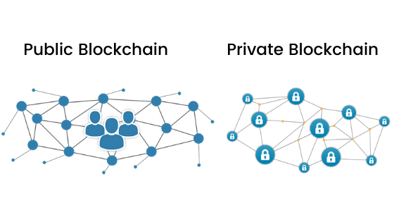
Private:
The private blockchain is within a single organization. It allows only specific people of the organization to verify and add transaction blocks. However, everyone on the internet is generally allowed to view it.

Slide 16
Private blockchain networks, also known as permissioned networks, on the other hand, are run by private organizations. The organization, a group or consortium acts as a means of centralization because it limits the participants based on given criteria and defines who connects to and transacts on the network.
An example of this is when a company wants to collaborate with a few others to share sensitive data that cannot be revealed through a public blockchain. These blockchains may or may not have a cryptocurrency or token as a native asset.
These are not as open as a public blockchain.
They are open to some authorized users only.
These blockchains are operated in a closed network.
In this few people are allowed to participate in a network within a company/organization.

Slide 17
Advantages:
Speed: The rate of the transaction is high, due to its small size. Verification of each node is less time-consuming.
Scalability: We can modify the scalability. The size of the network can be decided manually.
Privacy: It has increased the level of privacy for confidentiality reasons as the businesses required.

Slide 18
Disadvantages:
Security- The number of nodes in this type is limited so chances of manipulation are there. These blockchains are more vulnerable.
Centralized- Trust building is one of the main disadvantages due to its central nature. Organizations can use this for malpractices.
Count- Since there are few nodes if nodes go offline the entire system of blockchain can be endangered.

Slide 19
Public Blockchain | Private Blockchain
In this type of blockchain anyone can read, write and participate in a blockchain. Hence, it is permissionless blockchain. It is public to everyone. | In this type of blockchain read and write is done upon invitation, hence it is a permissioned blockchain.
Participants Don’t know each other | Participants Know each other
A public blockchain is decentralized. | A private blockchain is more centralized.
Transactions per second are lesser in a public blockchain. | Transaction per second is more as compared to public blockchain.
Slow | Fast
Examples: Bitcoin, Ethereum, Monero, Zcash, Dash, Litecoin, Stellar, Steemit etc. | Example: R3 (Banks), EWF (Energy), B3i (Insurance), Corda.

Slide 20
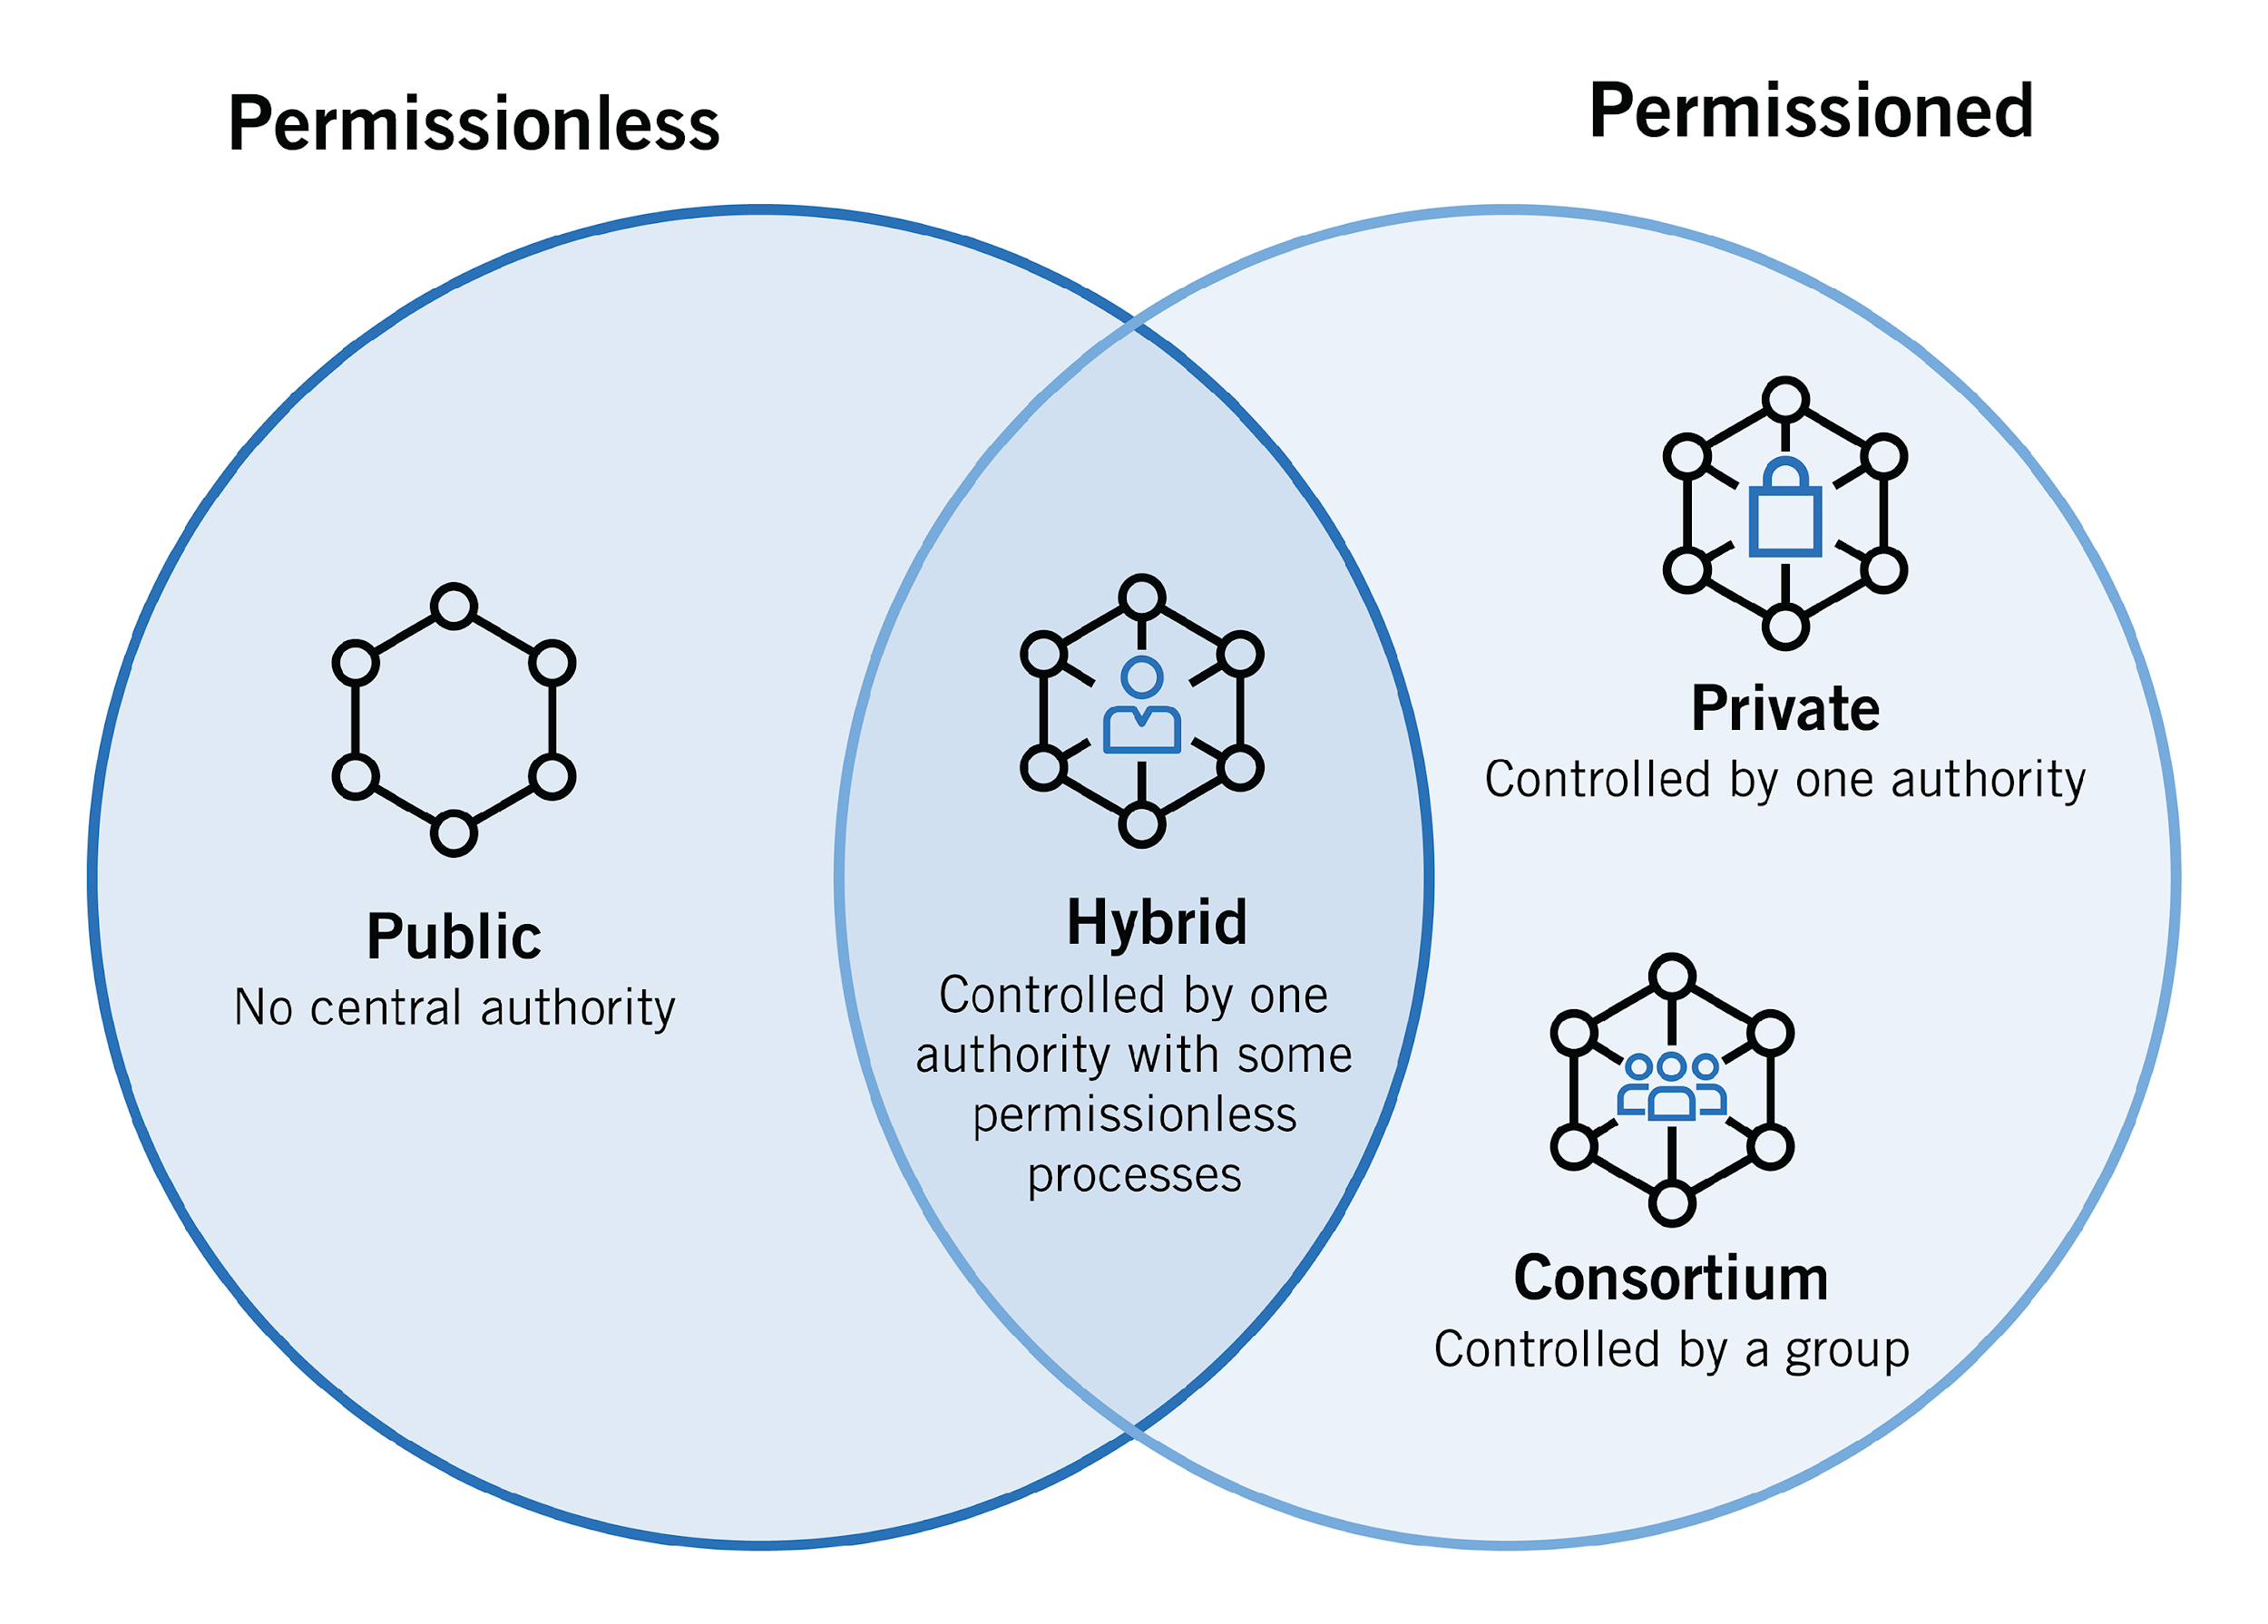

Slide 21
A hybrid blockchain combines the privacy benefits achieved on a permissioned network with the transparency benefits achieved on a public block chain.
An example of a hybrid blockchain network is the Dragonchain, which is a protocol that allows its users to connect with other users on other blockchain protocols
It is a combination of both public and private blockchain.
Permission-based and permissionless systems are used.
User access information via smart contracts

Slide 22
Advantages:
Ecosystem: Most advantageous thing about this blockchain is its hybrid nature. It cannot be hacked as 51% of users don’t have access to the network
Cost: Transactions are cheap as only a few nodes verify the transaction. All the nodes don’t carry the verification hence less computational cost.
Architecture: It is highly customizable and still maintains integrity, security, and transparency.
Operations: It can choose the participants in the blockchain and decide which transaction can be made public.

Slide 23
Disadvantages:
Efficiency: Not everyone is in the position to implement a hybrid Blockchain. The organization also faces some difficulty in terms of efficiency in maintenance.
Transparency: There is a possibility that someone can hide information from the user. If someone wants to get access through a hybrid blockchain it depends on the organization whether they will give or not.
Ecosystem: Due to its closed ecosystem this blockchain lacks the incentives for network participation

Slide 24
Consortium Blockchain
A consortium blockchain is managed by a group of organizations rather than being open to the public or controlled by a single entity.
Also known as Federated Blockchain.
Some part is public and some part is private.
In this type, more than one organization manages the blockchain.

Slide 25
Advantages:
Speed: A limited number of users make verification fast. The high speed makes this more usable for organizations.
Authority: Multiple organizations can take part and make it decentralized at every level. Decentralized authority, makes it more secure.
Privacy: The information of the checked blocks is unknown to the public view. but any member belonging to the blockchain can access it.
Flexible: There is much divergence in the flexibility of the blockchain. Since it is not a very large decision can be taken faster.

Slide 26
Disadvantages:
Approval: All the members approve the protocol making it less flexible. Since one or more organizations are involved there can be differences in the vision of interest.
Transparency: It can be hacked if the organization becomes corrupt. Organizations may hide information from the users.
Vulnerability: If few nodes are getting compromised there is a greater chance of vulnerability in this blockchain

Slide 27
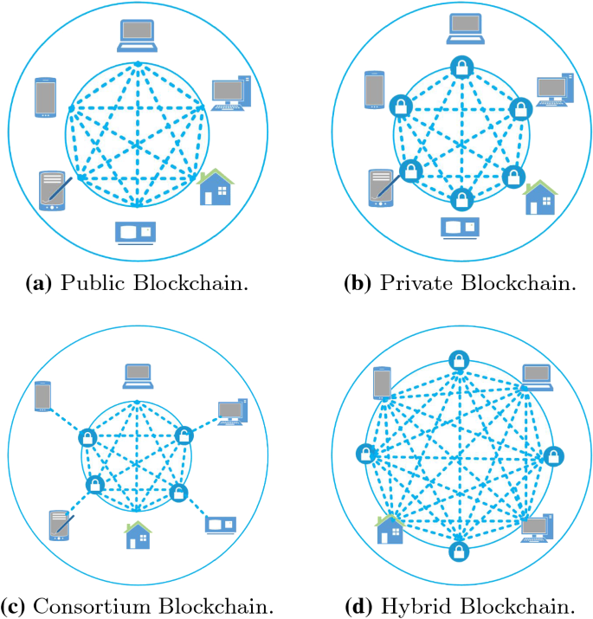

Slide 28
Blockchain Use Cases
Blockchain Technology is used widely in the different sectors as given in the following table.
Markets | Billing, monitoring and Data Transfer Quota management in the Supply Chain Network
Government Sector | Transnational personalized governance services Voting, propositions P2P bond, Digitization of documents/ contracts and proof of ownership for transfers Registry & Identify Tele-attorney service IP registration and exchange Tax receipts Notary service and document registry
IOT | Agricultural & drone sensor networks Smart home networks Integrated smartcity. Smart home sensors Self-driving car Personalized robots, robotic component Personalized drones Digital Assistants

Slide 29
Health | Data management Universal EMR Health databanks QS Data Commons Big health data stream analytes Digital health wallet Smart property Health Token Personal development contracts
Science & Art | Supercomputing Crowd analysis P2P resources Digital mind fit services
Finance & Accounting | Digital Currency Payment Payments & Remittance Decartelized Capital markets using a network of the computer on the Blockchain Inter-divisional accounting Clearing & Trading & Derivatives Bookkeeping

Slide 30
Real life use case of block chain
Walmart uses blockchain to track the provenance of its food products. This ensures food safety by allowing quick identification of contamination sources.
Medicalchain uses blockchain to securely store health records and ensure they can be accessed by authorized doctors and patients.
Propy uses blockchain to facilitate international real estate transactions by providing a secure and transparent process.

Slide 31
Civic uses blockchain technology to secure and verify digital identities, enabling secure access to services without the need for traditional identity documents.
Voatz provides a blockchain-based voting platform that ensures secure, transparent, and tamper-proof elections

Slide 32
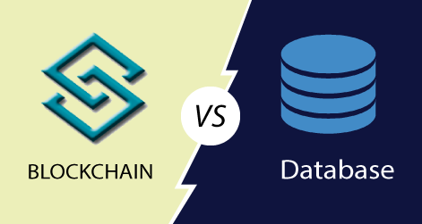

Slide 33
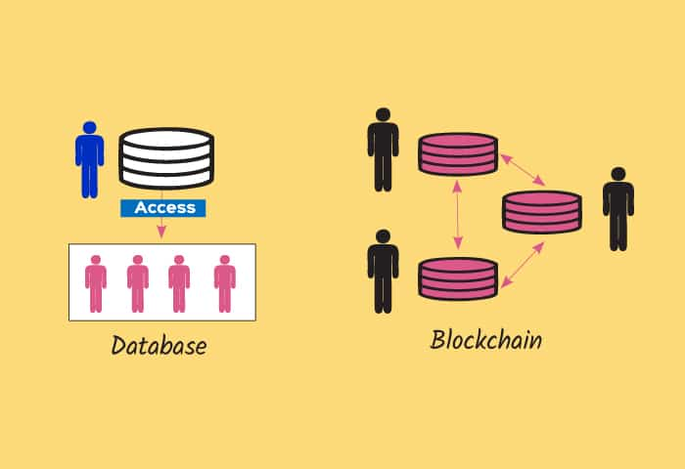

Slide 34
Database | Blockchain
Database uses centralized storage of data. | Blockchain uses decentralized storage of data.
Database needs a Database admin or Database administrator to manage the stored data. | There is no administrator in Blockchain.
Modifying data requires permission from database admin. | Modifying data does not require permission. Users have a copy of data and by modifying the copies does not affect the master copy of the data as Blockchain is irresistible to modification of data.
Centralized databases keep information that is up-to-date at a particular moment | Blockchain keeps the present information as well as the past information that has been stored before.
Centralized databases are used as databases for a really long time and have a good performance record, but are slow for certain functionalities. | Blockchain is ideal for transaction platform but it slows down when used as databases, specially with large collection of data.

Slide 35

What is Crypto currency
Cryptocurrency is a digital payment system that does not rely on banks to verify transactions.
Cryptocurrency payments exist purely as digital entries to an online database. When cryptocurrency funds are transferred, the transactions are recorded in a public ledger.
In cryptocurrency, “coins” (which are publicly agreed on records of ownership) are generated or produced by “miners”.

Slide 36
These miners are people who run programs on ASIC (Application Specific Integrated Circuit) devices made specifically to solve proof-of-work puzzles.
The work behind mining coins gives them value, while the scarcity of coins and demand for them causes their value to fluctuate.

Slide 37
Cryptocurrencies can be used for buying goods just like fiat currency.
Cryptocurrencies use encryption to verify and protect transactions.
It does not exist in physical form and is not typically issued by any central authority.
They use decentralized control in contrast to central bank digital currency.

Slide 38
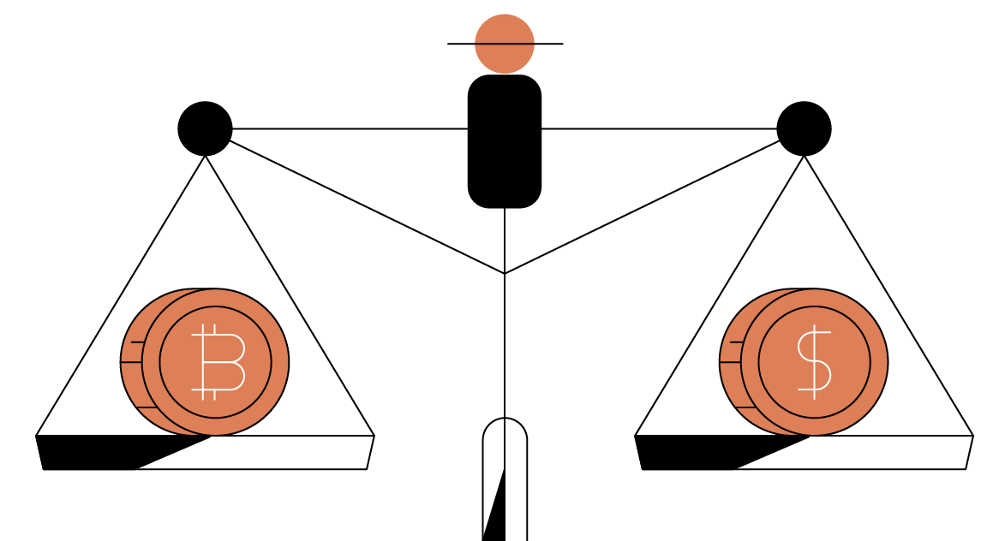
Cryptocurrency Working vs Fiat Currency Working
There are two things that make cryptocurrency working and fiat currency working different:
Transactions and the Consensus protocol.

Slide 39
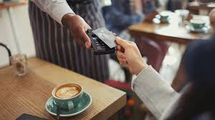
Fiat currency is the traditional money issued by governments. It is not backed by a physical commodity (like gold or silver) but rather by the government that issued it.
Example: US Dollar (USD)
Buying Coffee: You go to a coffee shop in the U.S. and pay $5 for a cup of coffee using a $5 bill or a credit card linked to your bank account.

Slide 40
Cryptocurrency is a digital or virtual currency that uses cryptography for security and operates independently of a central authority or government.
Example: Bitcoin (BTC)
Buying Coffee: You go to a coffee shop that accepts Bitcoin and order a coffee priced at 0.0005 BTC (equivalent to $5, assuming 1 BTC = $10,000). You scan a QR code with your Bitcoin wallet app and transfer 0.0005 Bitcoin to the shop's wallet. The transaction is recorded on the blockchain.

Slide 41
Example 2
Buying a Car: You decide to buy a car for $20,000. You can pay by writing a check, using a credit/debit card, or transferring the money from your bank account to the dealership’s account. The bank verifies you have enough funds and processes the transaction, updating your and the dealership’s account balances accordingly.
Buying a Car: You decide to buy a car for 1 Bitcoin. You open your Bitcoin wallet app, enter the dealership’s wallet address, and send 1 Bitcoin. The transaction is broadcast to the Bitcoin network, verified by miners, and recorded on the blockchain. The dealership sees the confirmed transaction and hands you the keys to your new car.

Slide 42
A consensus protocol is a mechanism used in distributed systems and blockchain networks to achieve agreement on a single data value among distributed processes or systems.
Proof of Work (PoW): Bitcoin
Proof of Stake (PoS):Ethereum 2.0

Slide 43
How Does Cryptocurrency Works?
Mining: Cryptocurrencies are generated through the process called Mining. In this process, the miners are required to solve a mathematical puzzle over a specially equipped computer system to be rewarded with bitcoins in exchange.
Buying, selling, and storing: Users can buy cryptocurrencies from central exchanges, brokers, or individual currency owners and sell crypto to them. Cryptocurrencies can be stored in wallets.
Investing: Cryptocurrencies can be transferred from one digital wallet to another. Cryptocurrencies can be used for the following purposes:

Slide 44
Buying goods and services.
Trade-in them.
Exchange them for cash.
Once the cryptocurrency is purchased, it needs to be stored safely to protect it from hackers. The usual place to store cryptocurrency is crypto wallets which can be physical devices or online software. Not all exchanges or brokers provide crypto wallet services.
The cryptocurrencies can be stored in these four places:

Slide 45
A custodial wallet is a type of cryptocurrency wallet where a third party, holds and manages the user's private keys on their behalf. This means that the user does not have direct control over their private keys; instead, they must trust the custodian to securely store and manage their funds.
Cold Wallet: These are also known as Hardware wallets. It is an offline wallet in which hardware connects to the computer and stores the cryptocurrency. The device connects to the internet at the time of sending and receiving cryptocurrency but other than that the cryptos are safely stored offline.
Hot Wallet: These are the applications that store cryptocurrencies online. These are available as desktop or mobile apps.
Paper Wallet: This is also known as a physical wallet. It is a printout of the public and private keys available as a string of characters or scannable QR codes. To send crypto scan the public and private keys and crypto will be received using the public keys.

Slide 46
 | Custodial Wallet | Cold Wallet | Hot Wallet | Paper Wallet
Definition | Third-party such as the crypto exchange store the cryptocurrency. | The hardware connects to the computer and stores the cryptocurrency. | Applications that store cryptocurrencies online | Physical storage of public and private keys.
Advantage | Simple and convenient method. Easy to access. No worry about losing your crypto wallet. | Highest level of security. | Gives control over crypto. Almost always free. Easy to use. | Maximum security at the lowest possible cost.
Disadvantage | The security risk of leaving crypto in third-party’s possession. | The process is slower compared to when storing crypto online. Cost of device. | Risk of being hacked. | Less user-friendly. Risk of losing a wallet.

Slide 47

What Can You Do With Cryptocurrency
Shopping: Some luxury retailers like Rolex and Patek Philippe accept cryptocurrency as a form of payment.
Insurance: Some insurance companies like Premier Shield insurance accept Bitcoin for premium payments.
Gift: Cryptocurrency can be a great gift for persons who want to learn and invest in new technology.
Travel: As crypto is not tied to a specific country, thus traveling with crypto can save a lot on money exchange fees.

Slide 48
Advantages of Cryptocurrencies
The following are some of the advantages of cryptocurrencies:
Private and Secure: Blockchain technology ensures user anonymity and at the same time the use of cryptography in blockchain makes the network secure for working with cryptocurrencies.
Decentralized, Immutable, and Transparent: The entire blockchain network works on the principle of shared ownership where there is no single regulating authority and the data is available to all the permissioned members on the network and is tamper-proof.

Slide 49
Advantages of Cryptocurrencies
Inflation Hedge: Cryptocurrencies are a good means of investing in times of inflation as they are limited in supply and there is a cap on mining any type of cryptocurrency.
Faster Settlement: Payments for most cryptocurrencies settle in seconds or minutes. Wire transfers at banks can cost more and often take three to five business days to settle.
Easy Transactions: Crypto transactions can be done more easily, in a private manner in comparison to bank transactions. using a simple smartphone and a cryptocurrency wallet, anyone can send or receive a variety of cryptocurrencies.

Slide 50
Disadvantages of Cryptocurrencies
Cybersecurity issues: Cryptocurrencies will be subject to cyber security breaches and may fall into the hands of hackers. Mitigating this will require continuous maintenance of security infrastructure.
Price Volatility: Cryptocurrencies are highly volatile in terms of price as they have no underlying value and there is a supply-demand-like equation that is used to determine the price of cryptocurrencies.

Slide 51
Scalability: Scalability is one of the major concerns with cryptocurrencies. Digital coins and tokens adoption is increasing rapidly but owing to the sluggish nature of the blockchain makes cryptocurrencies prone to transaction delays. Cryptocurrencies cannot compete with the number of transactions that payment giants like VISA, and Mastercard processes in a day.
Less awareness: Cryptocurrency is still a new concept for the people and the long-term sustainability of cryptocurrencies remains to be seen.

